Slide 1
Course: Cloud, Microservices and Applications
UNIT II: Virtualization
SESSION 11
Taxonomy of virtualization techniques
Pros and cons of Virtualization
Date: 6/8/2021

Slide 2
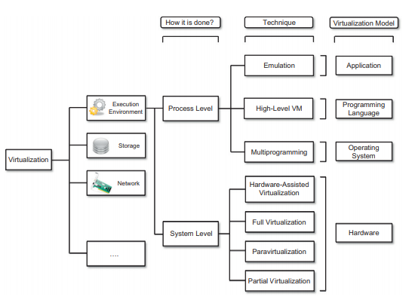

Slide 3
Storage virtualization
Storage virtualization is a system administration practice that allows decoupling the physical organization of the hardware from its logical representation.
Using this technique, users do not have to be worried about the specific location of their data, which can be identified using a logical path

Slide 4
Network virtualization
Network virtualization combines hardware appliances and specific software for the creation and management of a virtual network.
Network virtualization can aggregate different physical networks into a single logical network (external network virtualization) or provide network-like functionality to an operating system partition (internal network virtualization)

Slide 5
Desktop virtualization
Desktop virtualization abstracts the desktop environment available on a personal computer in order to provide access to it using a client/server approach.
Desktop virtualization provides the same outcome of hardware virtualization but serves a different purpose.
desktop virtualization strictly refers to the ability to remotely access a desktop environment, generally the desktop environment is stored in a remote server or a data center that provides a high-availability infrastructure and ensures the accessibility and persistence of the data

Slide 6
Application server virtualization
Application server virtualization abstracts a collection of application servers that provide the same services as a single virtual application server by using load-balancing strategies and providing a high-availability infrastructure for the services hosted in the application server

Slide 7
Advantages of virtualization
Managed execution and isolation
Portability
Self containment
Cost efficient
more efficient use of resources
Less energy consumption
Support Green IT

Slide 8
Disadvantages of virtualization
Performance degradation
Maintaining the status of virtual processors
Support of privileged instructions (trap and simulate privileged instructions)
Support of paging within VM
Console functions

Slide 9
Disadvantages of virtualization
Inefficiency and degraded user experience
Virtualization can sometime lead to an inefficient use of the host. In particular, some of the specific features of the host cannot be exposed by the abstraction layer and then become inaccessible

Slide 10
Disadvantages of virtualization
Security holes and new threats
Virtualization opens the door to a new and unexpected form of phishing
The capability of emulating a host in a completely transparent manner led the way to malicious programs that are designed to extract sensitive information from the guest.

Slide 11
Any Questions???

Slide 12
Thank You

